Slide 1
Intro to NodeJS & OS Concepts

Slide 2
Intro to FullStack Development
It refers to the development of both front end(client side) and back end(server side) portions of web application.
Front end:
It is the visible part of website or web application which is responsible for user experience. The user directly interacts with the front end portion of the web application or website.
The front end portion is built by using some languages such as –
HTML –
It is used to design the front end portion of web pages using Hypertext & Markup language.
Hypertext defines the link between the web pages.
The markup language is used to define the text documentation within tag which defines the structure of web pages.

Slide 3
Intro to FullStack Development
CSS –
It is a simply designed language intended to simplify the process of making web pages presentable.
CSS allows you to apply styles to web pages.
JavaScript –
It is used to make the site interactive for the user.
It is used to enhancing the functionality of a website and web-based software.

Slide 4
Intro to FullStack Development
Front end can also be developed using frameworks and libraries such as Angular, ReactJS, Bootstrap, JQUERY etc.
Angular –
It is a TypeScript based open source front-end framework that is mainly used to develop single page web applications(SPAs).
It changes the static HTML to dynamic HTML.
It extends HTML attributes with Directives, and data is bound with HTML.
ReactJS –
It is a declarative, efficient, and flexible JavaScript library for building user interfaces.
It is an open-source, component-based front end library responsible only for the view layer of the application.

Slide 5
Intro to FullStack Development
Front end can also be developed using frameworks and libraries such as Angular, ReactJS, Bootstrap, JQUERY etc.
Bootstrap –
It is a free and open-source tool collection for creating responsive websites and web applications.
It is the most popular HTML, CSS, and JavaScript framework for developing responsive, mobile-first web sites.
JQuery –
It is an open source JavaScript library that simplifies the interactions between an HTML/CSS document, or more precisely the Document Object Model (DOM), and JavaScript.
It simplifies HTML document traversing and manipulation, browser event handling, DOM animations, Ajax interactions, and cross-browser JavaScript development.

Slide 6
Intro to FullStack Development
Back end –
It refers to the server-side development of web application or website with a primary focus on how the website works.
It is responsible for managing the database through queries and APIs by client-side commands.
PHP –
It is a server-side scripting language designed specifically for web development.
Since, PHP code executed on server side so it is called server side scripting language.

Slide 7
Intro to FullStack Development
Java –
It is one of the most popular and widely used programming language and platform. It is highly scalable.
Java components are easily available.
Python –
It is a high-level, interpreted, general-purpose programming language.
Its design philosophy emphasizes code readability with the use of significant indentation.
Python is dynamically-typed and garbage-collected.

Slide 8
Intro to FullStack Development
NodeJS –
Node.js is an open-source and cross-platform runtime environment for executing JavaScript code outside a browser.
You need to remember that NodeJS is not a framework and it’s not a programming language.
We often use Node.js for building back-end services like APIs like Web App or Mobile App.
It’s used in production by large companies such as Paypal, Uber, Netflix, Walmart, and so on.
Back End Frameworks –
The list of back end frameworks are: Express, Spring, Django, Rails, Laravel etc.
The other back end program/scripting languages are: C#, Ruby, REST, GO etc.

Slide 9
Intro to FullStack Development
Database – Database is the collection of inter-related data which helps in efficient retrieval, insertion and deletion of data from database and organizes the data in the form of tables, views, schemas, reports etc.
Oracle –
It is the collection of data which is treated as a unit. The purpose of this database is to store and retrieve information related to the query.
MongoDB –
It is the most popular NoSQL database, which isn’t based on the table-like relational database structure but provides an altogether different mechanism for storage and retrieval of data.
SQL –
Structured Query Language is a standard Database language which is used to create, maintain and retrieve the relational database.

Slide 10
Intro to FullStack Development
Some Popular Stacks are –
MEAN Stack: MongoDB, Express, AngularJS and Node.js.
MERN Stack: MongoDB, Express, ReactJS and Node.js
Django Stack: Django, python and MySQL as Database.
Rails or Ruby on Rails: Uses Ruby, PHP and MySQL.
LAMP Stack: Linux, Apache, MySQL and PHP.

Slide 11
Intro to NodeJS
Node.js runs the V8 JavaScript engine, the core of Google Chrome, outside of the browser. This allows Node.js to be very performant.
A Node.js app runs in a single process, without creating a new thread for every request.
Node.js provides a set of asynchronous I/O primitives in its standard library that prevent JavaScript code from blocking.
Generally, libraries in Node.js are written using non-blocking paradigms, making blocking behavior the exception rather than the norm.

Slide 12
NodeJS Features
Node.js is really fast: Having been built on Google Chrome's V8 JavaScript engine, its library is extremely fast for code execution.
Node Package Manager (NPM): Node Package Manager has more than 1,000,000 packages, so whatever functionality is required for an application can be easily imported from NPM.
Node.js uses asynchronous programming: All APIs of Node.js library are asynchronous (i.e., non-blocking), so a Node.js-based server does not wait for the API to return data. The server calls the API, and if no data is returned, the server moves to the next API, here the “Events” module of Node.js helps the server get a response from the previous API call. This also helps with the speed of Node.js.
No buffering: Node.js dramatically reduces the processing time while uploading audio and video files. Node.js applications never buffer data and simply output the data in chunks.
Single-threaded: Node.js makes use of a single-threaded model with event looping. As a result, it can provide service to a much larger number of requests than traditional servers like Apache HTTP Server.
Highly scalable: Node.js server responds in a non-blocking way, making it highly scalable in contrast with traditional servers, which create limited threads to handle requests.

Slide 13
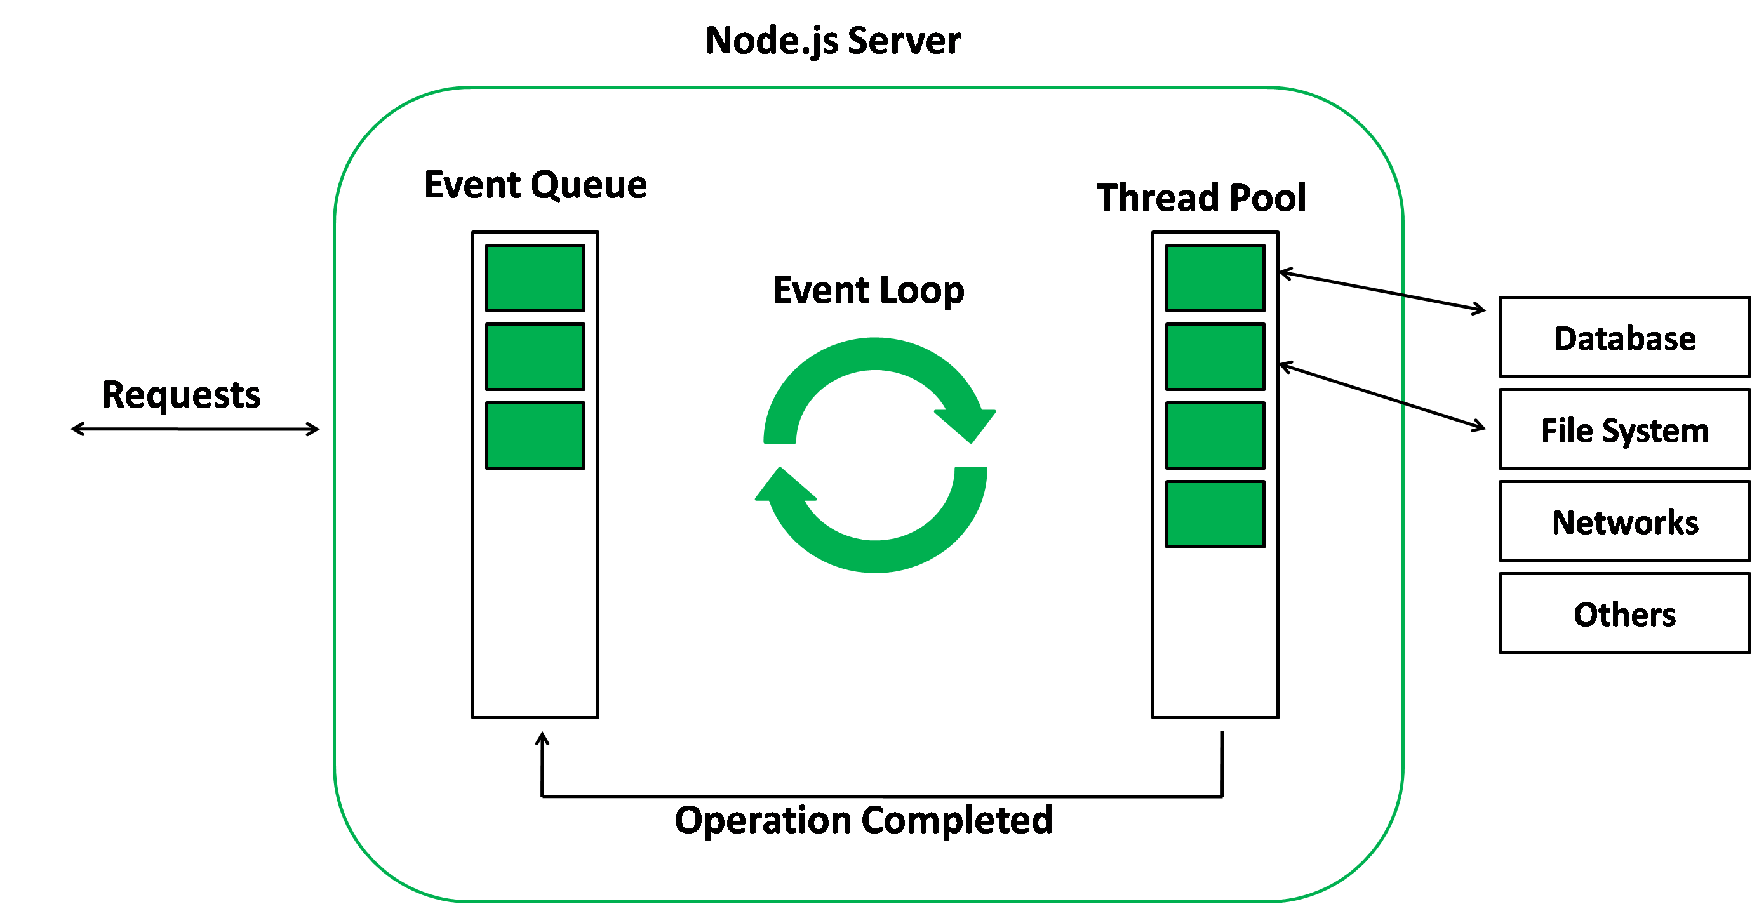
NodeJS Event Loop

Slide 14
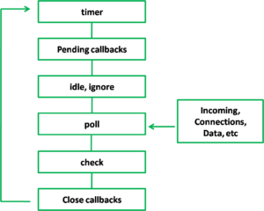
NodeJS Event Loop

Slide 15
NodeJS Modules
Module in Node.js is a simple or complex functionality organized in single or multiple JavaScript files which can be reused throughout the Node.js application.
Each module in Node.js has its own context, so it cannot interfere with other modules or pollute global scope. Also, each module can be placed in a separate .js file under a separate folder.
Node.js implements CommonJS modules standard. CommonJS is a group of volunteers who define JavaScript standards for web server, desktop, and console application.

Slide 16
NodeJS Modules
Node.js includes three types of modules:
Core Modules
Local Modules
Third Party Modules
Core Modules –
These modules are compiled into its binary distribution and load automatically when Node.js process starts.
However, you need to import the core module first in order to use it in your application.

Slide 17
NodeJS Modules
Core Module | Description
http | http module includes classes, methods and events to create Node.js http server.
url | url module includes methods for URL resolution and parsing.
querystring | querystring module includes methods to deal with query string.
path | path module includes methods to deal with file paths.
fs | fs module includes classes, methods, and events to work with file I/O.
util | util module includes utility functions useful for programmers.

Slide 18
NodeJS Modules
Local Modules –
Local modules are modules created locally in your Node.js application.
These modules include different functionalities of your application in separate files and folders.
You can also package it and distribute it via NPM, so that Node.js community can use it.

Slide 19
NodeJS Modules
<<Log.js>>
var log = {
info: function (info) {
console.log('Info: ' + info);
},
warning:function (warning) {
console.log('Warning: ' + warning);
},
error:function (error) {
console.log('Error: ' + error);
}
};
module.exports = log
Local Module Example (for logging) –
var myLogModule = require('./Log.js');
myLogModule.info('Node.js started');

Slide 20
NodeJS OS
OS is a node module used to provide information about the computer operating system.
It provides functions to interact with the operating system.
It provides the hostname of the operating system and returns the amount of free system memory in bytes.
Module named “os” needs to be required in a file to access its methods as shown below –
// Include os module and create its object
var os = require('os');

Slide 21
NodeJs OS
// return the cpu architecture console.log("CPU architecture: " + os.arch());
// It returns the amount of free system memory in bytes console.log("Free memory: " + os.freemem());
// It return total amount of system memory in bytes console.log("Total memory: " + os.totalmem());
// OS platform console.log('platform : ' + os.platform());
// It returns the list of network interfaces console.log('List of network Interfaces: ' + os.networkInterfaces());
// It returns the operating systems default directory for temp files. console.log('OS default directory for temp files : ' + os.tmpdir());

Slide 22
Thank you!
Any Questions?

